Slide 1
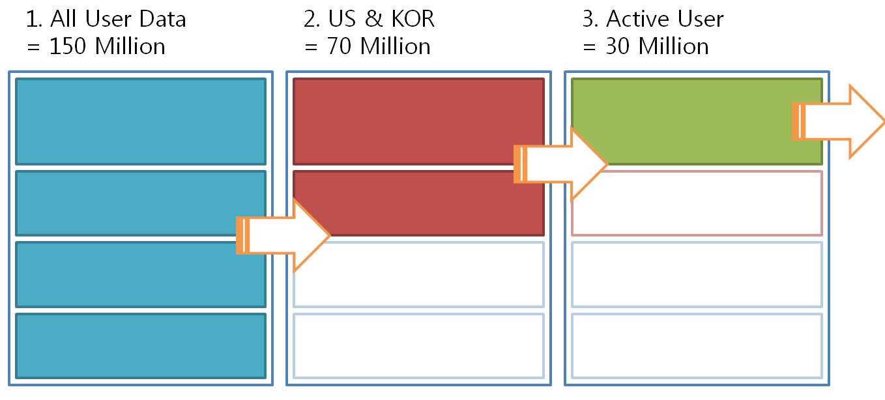
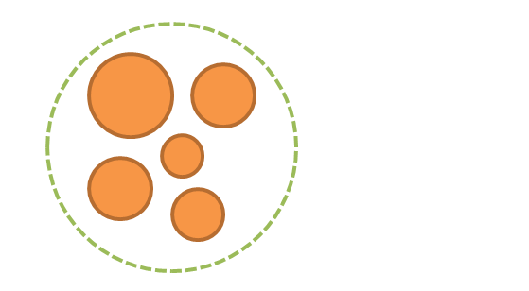

Slide 2
1. All User Data
= 150 Million
2. US & KOR
= 70 Million
3. Active User
= 30 Million

Slide 3
4. Active User
= 30 Million
4. Stratified Random Sampling
= 5000

